Slide 1

Master degree in
Computer Engineering for the Internet of Things
Course Name
Big Data Analytics
Project
Recommendation System for Spotify Users relying on Content-based Filtering approach
Professors
Andrea Tagarelli
Antonio Caliò
Speaker
Fabio Capparelli
GitHub Link for the code
click here

Slide 2
Recommendation System
Its aim is to suggest/recomend or predict possible user preferences or rating to a specific item.
They are used in the most known social media and content streaming platform such as Facebook, Instagram, YouTube, Spotify, Netflix, Amazon.
It uses many algorithms and approaches:
Collaborative filtering.
Content-based filtering.
Session-based recommender systems.
Hybrid recommender systems.

Slide 3
Content-based filtering
It suggests items only relying on their content and does not leverage on user behavior, interactions, rating on the platform/social media, two principal concepts:
The items content could be identified with its attributes, features or description.
The user profile is built following only user preferences and items in its platform database.

Slide 4
Content-based filtering
The use of this kind of approach has ensured to us the following PROS:
Major privacy, because we are not interested in the user actions, behavior.
No user rating is required.
The system is scalable, if the user preferences change (he/she adds new songs or new playlist) the system changes in a few time.
Otherwise, some “CONS” are:
It requires very accurate item description;
It is strictly depended on the item description/attributes and not in the real user like/rating, and sometimes these are not sufficient to perform an accurate recommendation.

Slide 5
Content-based filtering
This approach relies on three main steps:
Acquiring items/objects knowledge.
Acquiring user profile knowledge.
Performing dot product to select similar items.

Slide 6
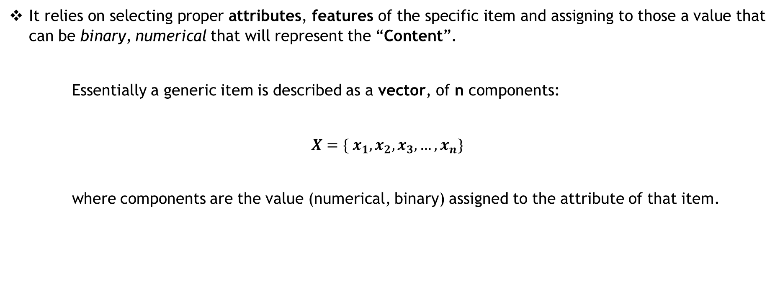
Acquiring items/objects knowledge.
It relies on selecting proper attributes, features of the specific item and assigning to those a value that can be binary, numerical that will represent the “Content”.
Essentially a generic item is described as a vector, of n components:
$$X=\{ x_{1}, x_{2}, x_{3},…, x_{n}\}$$
where components are the value (numerical, binary) assigned to the attribute of that item.

Slide 7
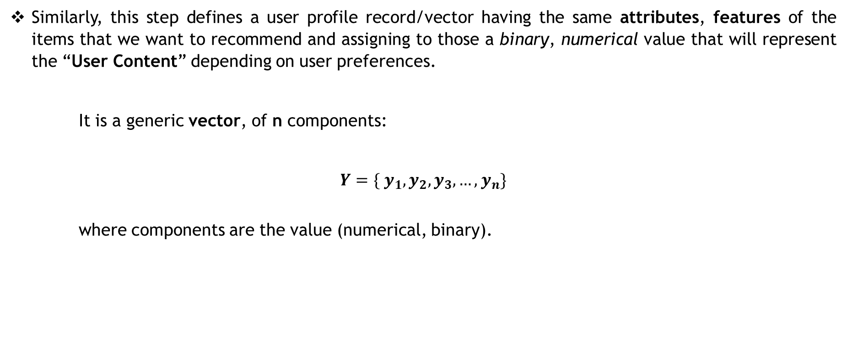
Acquiring user profile knowledge.
Similarly, this step defines a user profile record/vector having the same attributes, features of the items that we want to recommend and assigning to those a binary, numerical value that will represent the “User Content” depending on user preferences.
It is a generic vector, of n components:
$$Y=\{ y_{1}, y_{2}, y_{3},…, y_{n}\}$$
where components are the value (numerical, binary).

Slide 8
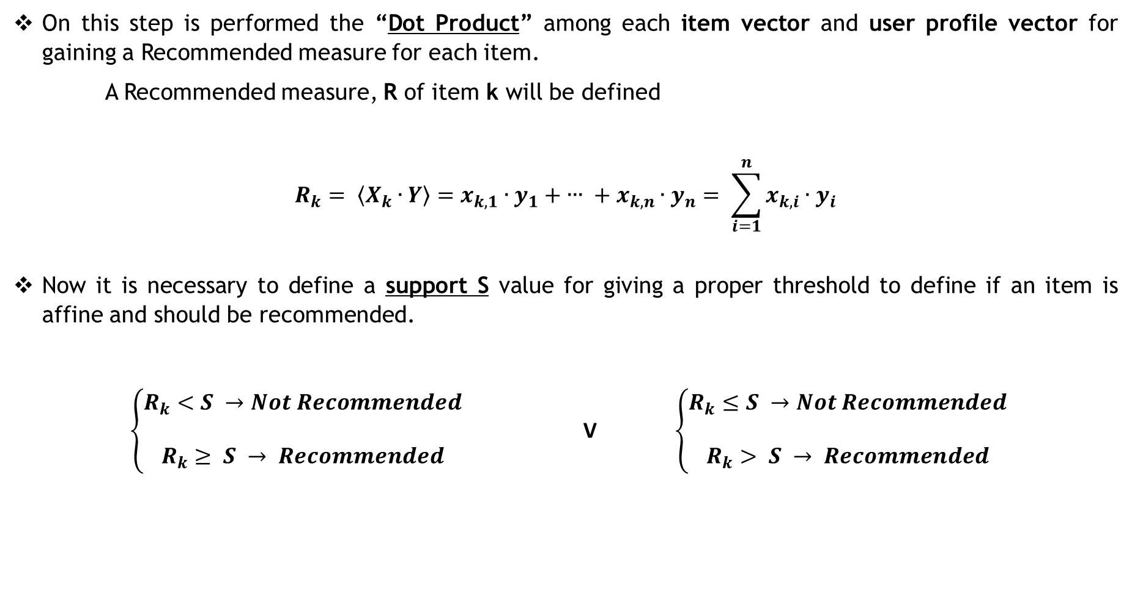
Performing the dot product
On this step is performed the “Dot Product” among each item vector and user profile vector for gaining a Recommended measure for each item.
A Recommended measure, R of item k will be defined
$$R_{k}= 〈X_{k}∙Y〉=x_{k,1}∙y_{1}+ ∙∙∙ + x_{k,n}∙y_{n}= \sum_{i=1}^{n}{x_{k,i}∙y_{i}}$$
Now it is necessary to define a support S value for giving a proper threshold to define if an item is affine and should be recommended.
$\left\{\begin{aligned}R_{k}<S →Not Recommended \\ \\ R_{k}≥ S → Recommended\end{aligned}\right.$ V $\left\{\begin{aligned}R_{k}≤S →Not Recommended \\ \\ R_{k}> S → Recommended\end{aligned}\right.$

Slide 9
Our System
Our solution is based on the following three steps, according to what has been said before:
Building the user profile getting the “audio_features” of the song inside the user playlists.
Getting the items “audio_features” of about 500 tracks of the newest albums uploaded on spotify.
Building the final recommender system performing the dot product among the user profile to all newest tracks and selecting the tracks that have the result above a support provided as input via console.

Slide 10
The Content
We rely on the tracks’ audio_features, that are parameter/attributes which characterize each song inside spotify, we considered the following:
Danceability
Energy
Liveness
Speechiness
Acousticness
Instrumentalness
Tempo
Valence

Slide 11
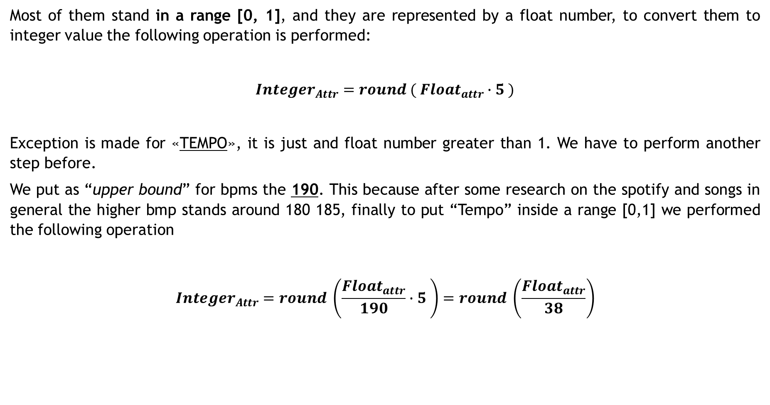
The Content Preprocessing
Most of them stand in a range [0, 1], and they are represented by a float number, to convert them to integer value the following operation is performed:
$$In{teger}_{Attr}=round ( Float_{attr}∙5 )$$
Exception is made for «TEMPO», it is just and float number greater than 1. We have to perform another step before.
We put as “upper bound” for bpms the 190. This because after some research on the spotify and songs in general the higher bmp stands around 180 185, finally to put “Tempo” inside a range [0,1] we performed the following operation
$$In{teger}_{Attr}=round \left(\frac{{Float}_{attr}}{190}∙5 \right)=round \left(\frac{{Float}_{attr}}{38}\right)$$

Slide 12
STEP 1
BUINLDING THE USER_RECORD
On this step we get the user’s songs inside his/her playlists, the steps followed have been:
Collect tracks inside an array deleting duplicates.
Retrieve the attributes we are interested in, in combination with some header attributes (id, name, artists, reference link).
Perform the preprocessing stage described before and store the inside proper dataset.
Perform the mean for each attribute (danceability, energy, … , tempo)
Obtain the user_record.

Slide 13
STEP 1
BUINLDING THE USER_RECORD
Attributes of a track inside a user playlist:
ID | Name | Artist | Link | Danceability | Energy | Liveness | Speechiness | Acousticness | Instrumentalness | Tempo | Valence
f3e2039043474108 | Zitti e buoni | Maneskin | click | 0.625 | 0.939 | 0.424 | 0.0669 | 0.00138 | 0 | 102.999 | 0.644
After preprocessing:
ID | Name | Artist | Link | Danceability | Energy | Liveness | Speechiness | Acousticness | Instrumentalness | Tempo | Valence
f3e2039043474108 | Zitti e buoni | Maneskin | click | 3 | 5 | 2 | 0 | 0 | 0 | 3 | 3

Slide 14
STEP 1
BUINLDING THE USER_RECORD
User record example for ‘Fabio Capparelli’
ID | Name | Link | Danceability | Energy | Liveness | Speechiness | Acousticness | Instrumentalness | Tempo | Valence
11102339711 | Fabio Capparelli | click | 3 | 3 | 1 | 1 | 1 | 0 | 3 | 2
User record example for ‘Francesco Raco’:
ID | Name | Link | Danceability | Energy | Liveness | Speechiness | Acousticness | Instrumentalness | Tempo | Valence
prp468n1n5qp2sdr1ps5hk8t0 | Francesco Raco | click | 3 | 3 | 1 | 0 | 1 | 0 | 3 | 3
User record example for ‘Luigi Rachiele’:
ID | Name | Link | Danceability | Energy | Liveness | Speechiness | Acousticness | Instrumentalness | Tempo | Valence
gixs | Luigi Rachiele | click | 3 | 3 | 1 | 0 | 1 | 1 | 3 | 2

Slide 15
STEP 2
RETRIEVE THE NEWEST SONGS
On this step we get the spotify new releases:
Get newest published albums
Up to 500 hundred songs
Perform preprocessing for each song
Store the into a similar dataset used for user’s playlists songs

Slide 16
STEP 3
SUGGEST NEW SONGS
On this step we recommend new tracks for the spotify user:
Perform the “Dot Product” among user record and each new song
Set a proper support S value in range [0,1].
Select only the songs that has as result a recommended value above the support S
Print suggested song.

Slide 17
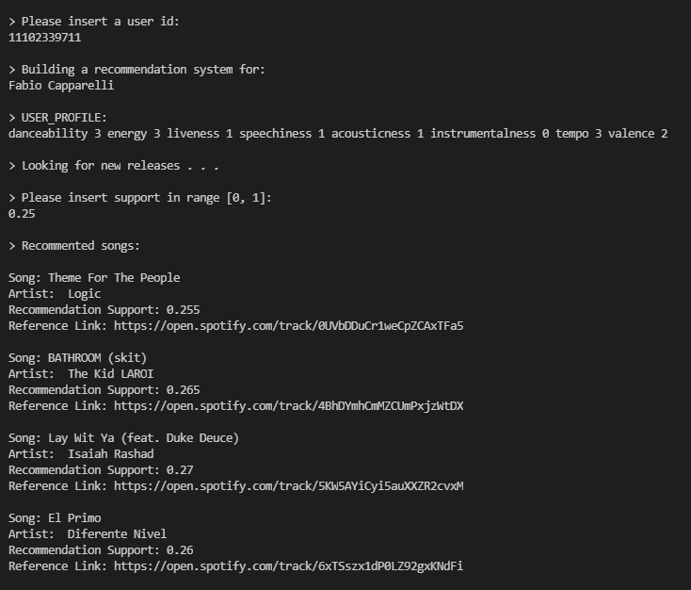
STEP 3
OUR RECCOMENDATION FOR FABIO CAPPARELLI

Slide 18
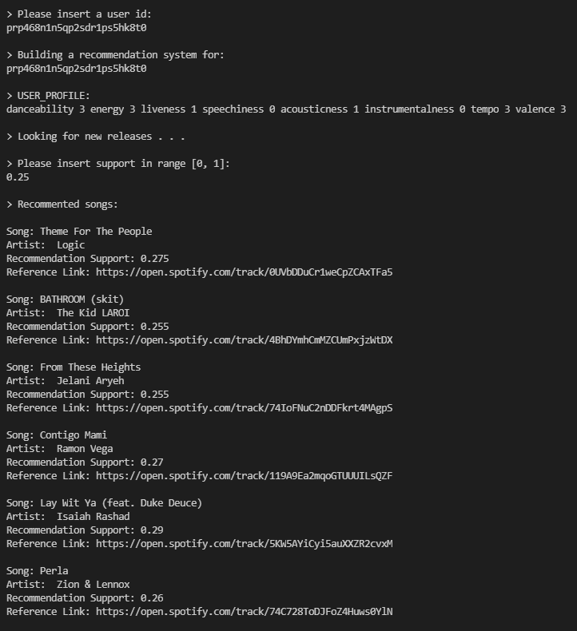
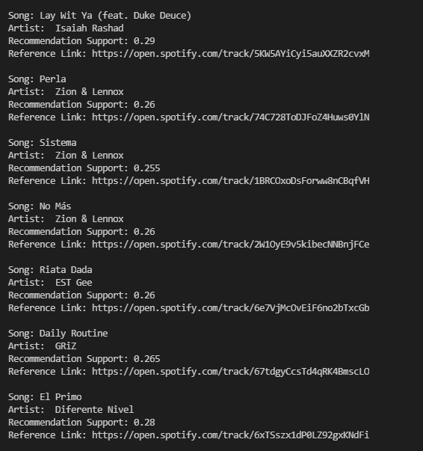
STEP 3
OUR RECCOMENDATION FOR FRANCESCO RACO

Slide 19
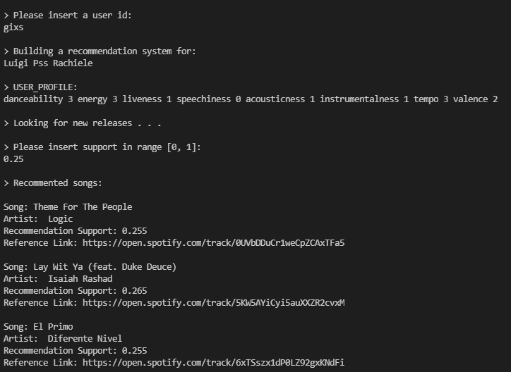
STEP 3
OUR RECCOMENDATION FOR LUIGI RACHIELE

Slide 20
THANKS FOR THE ATTENTION

